Slide 1
Unit-7
Recurrent Neural Network

Slide 2
Introduction to RNN
Recurrent Neural Network(RNN) are a type of neural Network where the output from previous step are fed as input to the current step.
In traditional neural networks, all the inputs and outputs are independent of each other, but in cases like when it is required to predict the next word of a sentence, the previous words are required and hence there is a need to remember the previous words.

Slide 3
Introduction to RNN
Thus RNN came into existence, which solved this issue with the help of a Hidden Layer. The main and most important feature of RNN is Hidden state, which remembers some information about a sequence.
RNN have a “memory” which remembers all information about what has been calculated. It uses the same parameters for each input as it performs the same task on all the inputs or hidden states to produce the output.

Slide 4
Introduction to RNN
Thus, RNN converts the independent activations into dependent activations by providing the same weights and biases to all the layers, thus reducing the complexity of increasing parameters and memorizing each previous outputs by giving each output as input to the next hidden layer (see right part of the figure in next slide).
Hence layers of neural network in right side can be joined together such that the weights and bias of all the hidden layers is the same, into a single recurrent layer.

Slide 5
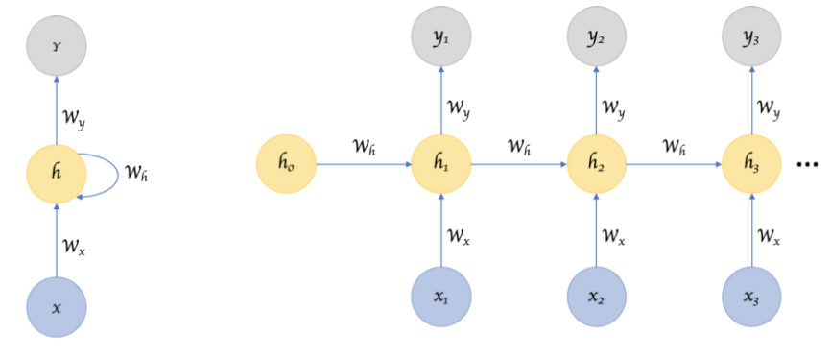
Introduction to RNN
≡

Slide 6
Introduction to RNN
Applications of RNN
Time series prediction
Sequence prediction
Natural Language Processing
Speech processing

Slide 7
Forward Propagation in RNN
Example: Consider the word ‘dogs’. Show forward propagation of RNN with three nodes in hidden layer to predict letter ‘s’ given the letters ‘d’, ‘o’, and ‘g’. Assume that hidden layer activation function is Tanh and activation in output layer is softmax.
Solution
One hot encoding of the input: input vocabulary{d, o, g, s}
d | o | g | s
1 | 0 | 0 | 0
0 | 1 | 0 | 0
0 | 0 | 1 | 0
0 | 0 | 0 | 1

Slide 8
Forward Propagation in RNN
We know that:
Here, dimension of w_{h} is d × d, dimension of w_{x} is d × k, and dimension of w_{y} is k × d. Where, d is number of hidden nodes, and k is dimension of input vector.
Assume that:

Slide 9
Forward Propagation in RNN
Thus, (for input ‘d’)
At t=1, RNN predicts the letter “d” given the input “d”. This doesn’t make sense but it’s ok because we’ve used untrained random weights.

Slide 10
Forward Propagation in RNN
Example: Consider the input series {0.2,0.4,0.6, 0.8}. Show forward propagation of RNN with two nodes in hidden layer to predict next term in the series. Assume that activation function of hidden layer is sigmoid and activation in output layer is linear.
Solution {Input: 0.2 }

Slide 11
Computational Power of recurrent Networks
Computational power of recurrent neural network is based on following theorem.
Theorem: All Turing machines may be simulated by fully connected recurrent networks built on neurons with sigmoidal activation functions ((Siegelmann and Sontag, 1991).
They show that, for every computable function, there exists a finite RNN (of the form described above) that can compute it. They do this by showing that it's possible to use a RNN to explicitly simulate a pushdown automaton with two stacks.

Slide 12
Computational Power of recurrent Networks
This is another model that's computationally equivalent to a Turing machine. Any computable function can be computed by a Turing machine. Any Turing machine can be simulated by a pushdown automaton with two stacks.
Any pushdown automaton with two stacks can be simulated by a RNN. Therefore, any computable function can be computed by a RNN.

Slide 13
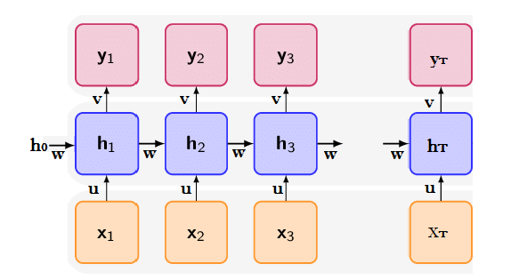
Backpropagation Through Time (BPTT)
BPTT is gradient based algorithm for training recurrent neural networks.
Unrolling of RNN with T layers looks like below, where w, u, v are weigh matrices.

Slide 14
Backpropagation Through Time (BPTT)
Let L is total loss in the RNN. Then the weights w, u, v are updated as below.
Thus, we need to compute for updating weights.

Slide 15
Backpropagation Through Time (BPTT)
Let L_{t} is the loss at t^{th} step of RNN. Then total loss of the RNN is given by.
Loss function can be different according to need. Basically, cross-entropy or least square loss function is used. Normally, Cross-entropy loss function is used for classification problems whereas least square loss function is used for regression problems.

Slide 16
Backpropagation Through Time (BPTT)
Recall that computation of hidden state and output in RNN is performed as below:
Recall that, we need to compute for BPTT. Assume that t=3
Also, assume that

Slide 17
Backpropagation Through Time (BPTT)
Now,
Here,
In the above relation derivative of h₂ needs to be computed recursively in terms of h₁.

Slide 18
Backpropagation Through Time (BPTT)
Finally,
Again, in the above relation, derivative of h₂ needs to be computed recursively in terms of h₁.
Since the derivatives needs to be calculated recursively by back propagating through time the algorithm is named as BPTT.

Slide 19
Backpropagation Through Time (BPTT)
Algorithm
For i=1 to T Compute y_{i} and L_{i} as below
For i=1 to T Compute following gradients
Find total gradient by summing all local gradients
Update weights as below

Slide 20
Vanishing Gradient and Truncated BPTT
Two main problems associated with Recurrent Neural networks are:
Gradient calculations either vanish or explode
Gradient calculations are expensive
Solution to exploding gradient is gradient clipping and solution to vanishing gradient problem is to use alternate architectures like gated recurrent unit (GRU) network and Long Short-term Memory (LSTM) network. Both, GRU and LSTM are variants of RNN architecture.
Solution to second problem is to used truncated BPTT algorithm

Slide 21
Vanishing Gradient and Truncated BPTT
RNNs might have a difficulty in learning long range dependencies. For instance if we have a sentence like “The man who ate my pizza has purple hair”. In this case, the description purple hair is for the man and not for the pizza. So this is a long dependency.
In BPTT algorithm, we need to compute gradient of loss to update weights.
In order to compute loss we need to use recursive computation.
For instance following two gradients can be computed as below.

Slide 22
Vanishing Gradient and Truncated BPTT
In the above equations gradient of h_{t-1} needs to be computed recursively in terms of h_{t-2} . Thus, the weight matrix w is multiplied by many times while computing the gradients.

Slide 23
Vanishing Gradient and Truncated BPTT
If w is small, we experience a vanishing gradient problem. And if w is large, we experience an exploding gradient problem.
The lower the gradient is, the harder it is for the network to update the weights and the longer it takes to get to the final result.
Exploding gradients are a problem where large error gradients accumulate and result in very large updates to neural network model weights during training. This has the effect of our model being unstable and unable to learn from your training data.

Slide 24
Vanishing Gradient and Truncated BPTT
In BPTT algorithm we need to back propagate through entire sequence in order to compute gradient of local loss. Thus, computation of gradient of loss is time consuming process.
The practical solution is limit the backpropagation to a maximum of window of M steps. The forward pass should still be performed over the entire sequence, but the backward pass is truncated to windows of size M.
This modified version of BPTT algorithm is called Truncated BPTT or TBPTT.

Slide 25
Vanishing Gradient and Truncated BPTT
The TBPTT algorithm can be summarized as below:
Present a sequence of k1 time steps of input and output pairs to the network.
calculate and accumulate errors across k2 time steps.
update weights.
Repeat
As we can clearly see that you need two parameters namely k1 and k2 for implementing TBPTT. K1 is the number of forward pass time steps between updates. This influences how fast or slow will be the training and the frequency of the weight updates.

Slide 26
Vanishing Gradient and Truncated BPTT
On the other hand, k2 is the number of time steps which apply to BPTT. It should be large enough to capture the temporal structure in the problem for the network to learn.
But the problem with TBPTT is that the network can’t learn long dependencies as in BPTT because of limit on flow of gradient due to truncation.

Slide 27
Long Short-term Memory
Because of the vanishing gradient problem, RNNs cannot remember long-term dependencies in time series data.
LSTM is an RNN variant designed to address this issue. LSTM, like RNN, has a hidden state that serves as short-term memory.
Furthermore, it maintains cell state, which serves as long-term memory.

Slide 28
Long Short-term Memory
The LSTM architecture is made up of three gates: a forget gate, an input gate, and an output gate.
The forget gate is in charge of determining what information must be remembered and what can be forgotten from the previous state.
The input gate determines which information from the current input is stored in the cell state.

Slide 29
Long Short-term Memory
Finally, the output gate determines the next hidden state value.
The LSTM network's architecture is depicted in the Figure and mathematical formulation is given in Equation given in next slide..

Slide 30
Long Short-term Memory
×
+
C_{t}
C_{t-1}
×
σ
σ
tanh
tanh
σ
×
H_{t}
H_{t-1}
x_{t}

Slide 31
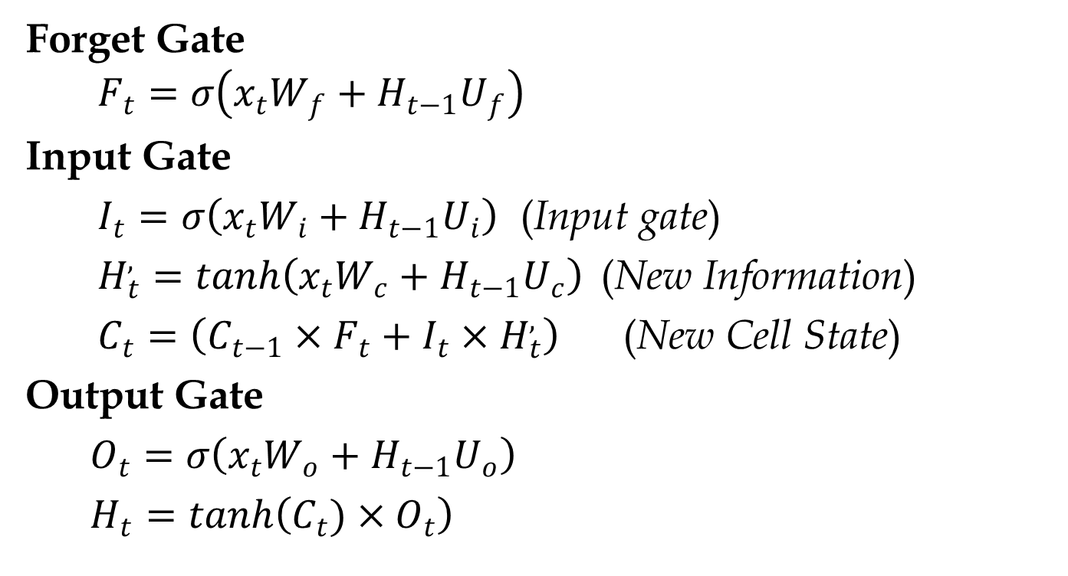
Long Short-term Memory
Forget Gate
$$F_{t}=σ\left(x_{t}W_{f}+H_{t−1}U_{f}\right)$$
Input Gate
$I_{t}=σ\left(x_{t}W_{i}+H_{t−1}U_{i}\right)$ (Input gate)
$H_{t}^{,}=tanh\left(x_{t}W_{c}+H_{t−1}U_{c}\right)$ (New Information)
$C_{t}=\left(C_{t−1}×F_{t}+I_{t}×H_{t}^{,}\right)$ (New Cell State)
Output Gate
$O_{t}=σ\left(x_{t}W_{o}+H_{t−1}U_{o}\right)$
$H_{t}=tanh\left(C_{t})×O_{t}\right)$

Slide 32
Long Short-term Memory
Here, W_{f} , W_{i}, W_{o}, U_{f}, U_{i}, and U_{o} are weight matrices. x_{t} is input at time step t, H_{t} is hidden state at time t, C_{t} is cell state at time t, O_{t} is output at time t, and H’_{t} is candidate hidden state at time t. × is point-wise multiplication and + is point-wise addition.

Slide 33
Gated Recurrent Unit Network
GRU is another popular RNN variant that is used to solve the vanishing gradient problem.
GRU, like LSTM, employs a gating mechanism to remember long-term dependencies. However, its structure is simpler than that of LSTM.
As a result, training takes less time. GRU networks have been shown in studies to perform similarly to LSTM networks.
Unlike LSTM, GRU does not maintain a separate cell state. It only keeps a hidden state.

Slide 34
Gated Recurrent Unit Network
The network only has two gates: an update gate and a reset gate.
The reset gate controls how much of the previous knowledge is erased. It is in charge of the network's short-term memory.
The update gate determines how much past knowledge must be passed on into the future. It is in charge of the network's long-term memory.
Finally, the results of both gates are used to compute the network's current hidden state.

Slide 35
Gated Recurrent Unit Network
The network's architecture is depicted in the Figure given below, and its mathematical formulation is given in the Equation given in next slide.
+
×
×
+
σ
+
H’_{t}
×
1-U_{t}

Slide 36
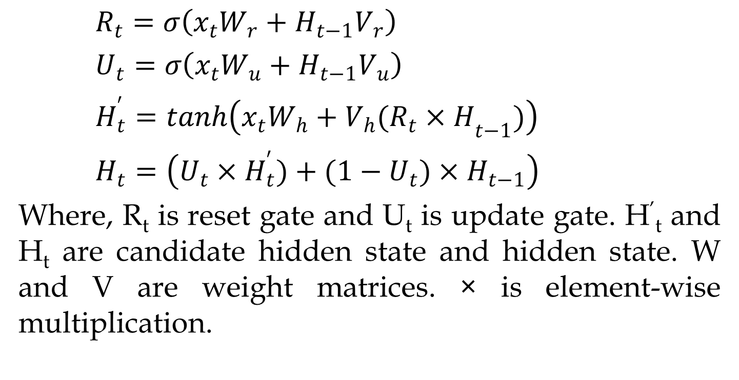
Gated Recurrent Unit Network
$R_{t}=σ\left(x_{t}W_{r}+H_{t−1}V_{r}\right)$
$U_{t}=σ\left(x_{t}W_{u}+H_{t−1}V_{u}\right)$
$H_{t}^{′}=tanh\left(x_{t}W_{h}+{V_{h}(R_{t}×H}_{t−1})\right)$
$H_{t}=\left(U_{t}×H_{t}^{′})+(1−U_{t})×H_{t−1}\right)$
Where, R_{t} is reset gate and U_{t} is update gate. H’_{t} and H_{t} are candidate hidden state and hidden state. W and V are weight matrices. × is element-wise multiplication.

Slide 37
Hopfield Networks
Hopfield networks are single layer recurrent neural networks that consists of n fully connected neurons.
This networks acts as associative memory of content addressable memory and is used for different pattern recognition problem.
An associative memory stores a set of p patterns in such a way that when presented with a new pattern, the network responds by producing whichever one of the stored patterns most closely resembles.

Slide 38
Hopfield Networks
In this network every neuron acts input as well as output node.
No connection from a node to itself is allowed in this type of neural network.
Hopfield nets can be discrete or continuous. Furthermore, Discrete Hopfield nets can be binary or bipolar.
Binary Hopfield nets produce 0 or 1 output whereas bipolar nets produce 1 or -1 output.

Slide 39
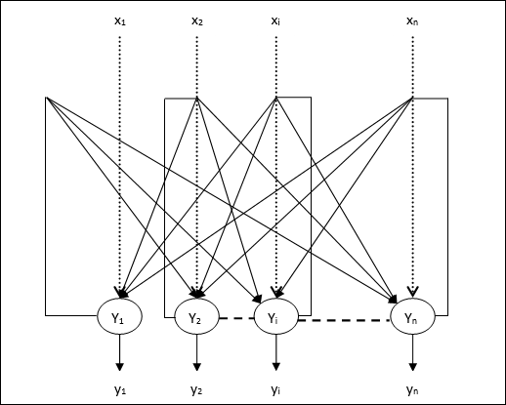
Hopfield Networks
Architecture of Hopfield network is given below.

Slide 40
Hopfield Networks
In this network every neuron acts input as well as output node.
No connection from a node to itself is allowed in this type of neural network.
Hopfield nets can be discrete or continuous. Furthermore, Discrete Hopfield nets can be binary or bipolar.
Binary Hopfield nets produce 0 or 1 output whereas bipolar nets produce 1 or -1 output.

Slide 41
Boltzmann Machine
Boltzmann Machine is a kind of recurrent neural network where the nodes make binary decisions and are present with certain biases.
It consists of a network of symmetrically connected, neuron-like units that make decisions stochastically whether to be active or not.
Boltzmann machines have a simple learning algorithm that allows them to discover interesting features in datasets composed of binary vectors.

Slide 42
Boltzmann Machine
Some important points about Boltzmann Machine.
They use recurrent structure.
They consist of stochastic neurons, which have one of the two possible states, either 1 or 0.
Some of the neurons in this are adaptive and some are clamped.
If we apply simulated annealing on discrete Hopfield network, then it would become Boltzmann Machine.

Slide 43
Boltzmann Machine
The main purpose of Boltzmann Machine is to optimize the solution of a problem. It is the work of Boltzmann Machine to optimize the weights and quantity related to that particular problem.
The following diagram shows the architecture of Boltzmann machine. It is clear from the diagram, that it is a two-dimensional array of units. Here, weights on interconnections between units are –p where p > 0. The weights of self-connections are given by b where b > 0.

Slide 44
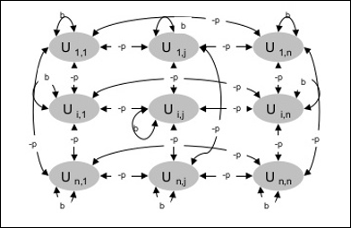
Boltzmann Machine

